Slide 1
Capstone Project 8 Domain: Financial Services Title: Exploratory Data Analysis & Credit Assessment in Financial Services

Slide 2
AGENDA
The dataset consists of customer information for L&T Financial Services, including demographics, loan disbursals, asset costs, previous accounts, and credit scores from Credit Bureaus of India.
The primary challenge is to target the right customers for loan disbursals. To achieve this, the credit team analyzes various factors like CIBIL score, payment history, credit history, geographical location, profession, income, age, and education.
This analysis helps determine the customer's capacity to repay the loan, reducing Non-Performing Assets (NPAs), and increasing profitability.

Slide 3
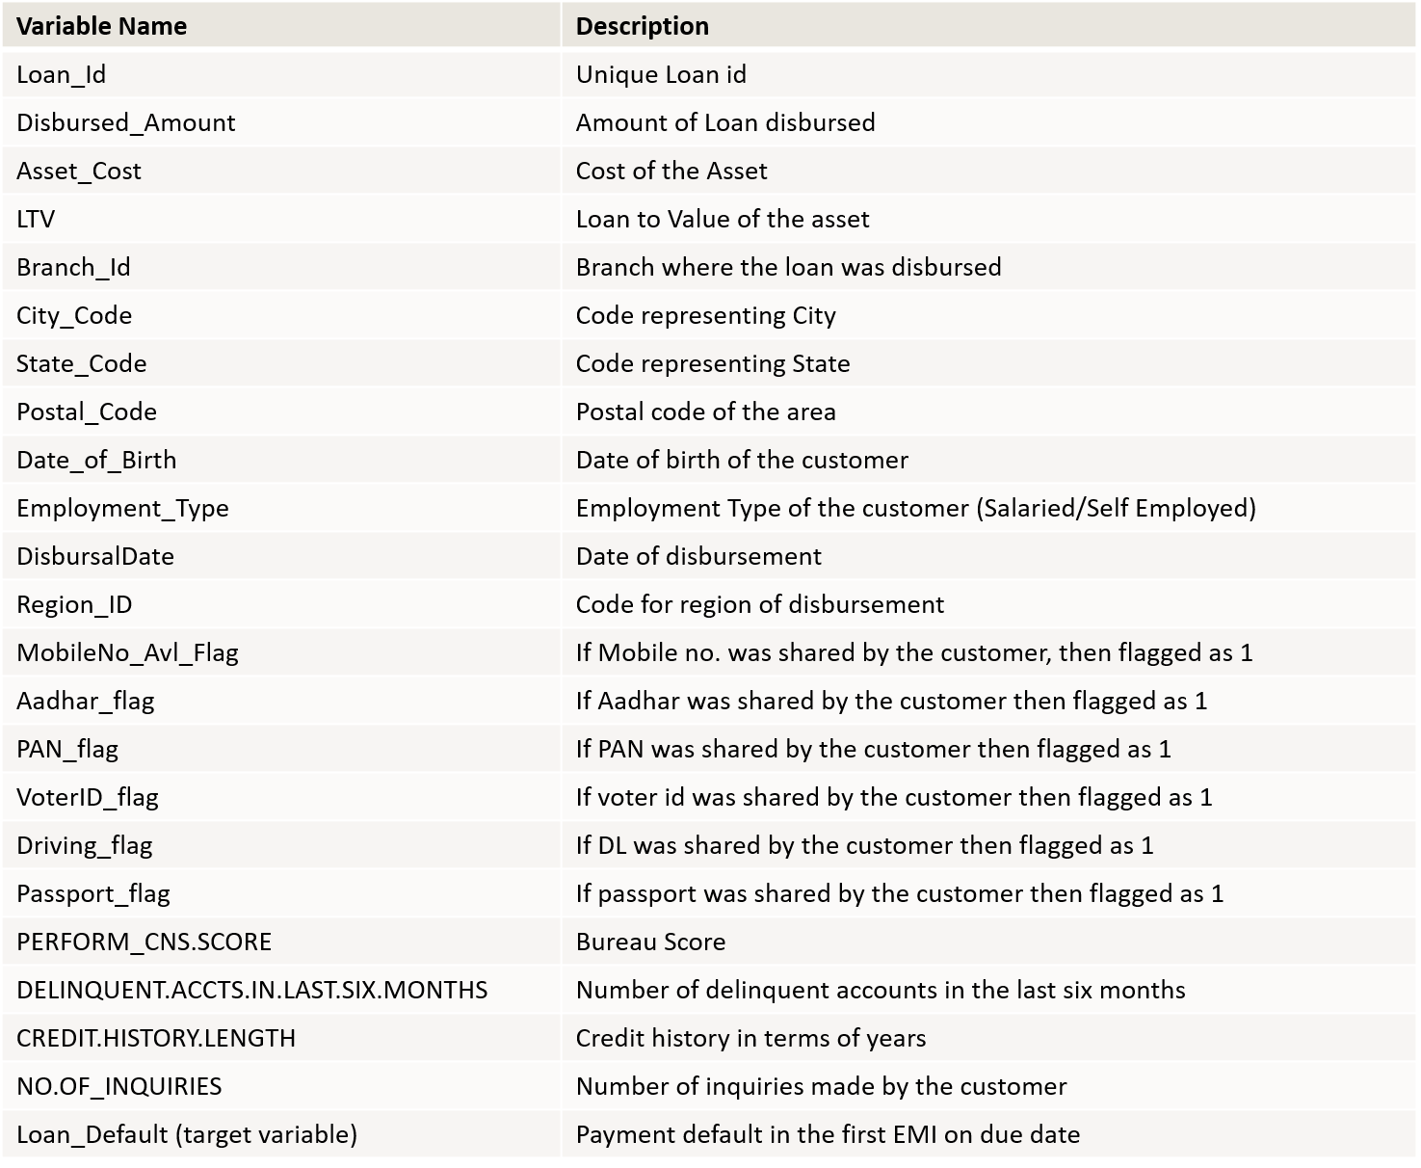
Data Dictionary

Slide 4
CheckPoint 1
Analysis(Univariate, Bivariate)
Heatmaps
IMPORTING
PACKAGES & DATA
Packages – numpy, pandas, seaborn, matplotlib, plotly, scipy, sklearn, imblearn.
Loading datasets.
DATA
EXPLORATION
data.describe()
data.info()
DATA
CLEANING
Handling Missing Values
Outliers Handling
Encoding Technique
Convert catagorical
data into numerical
DATA
VISUALIZATION
DATA
TRANSFORMATION
data.shape

Slide 5
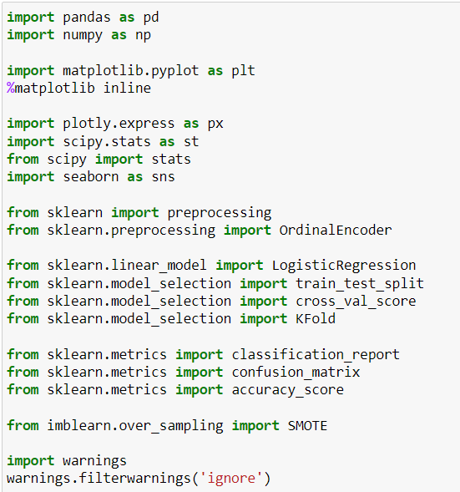
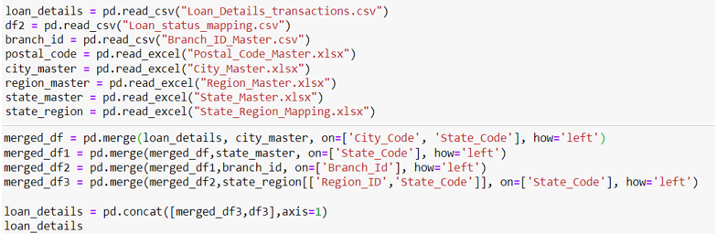
IMPORTING
PACKAGES & DATA
IMPORTING
PACKAGES
IMPORTING
DATA & MERGING

Slide 6
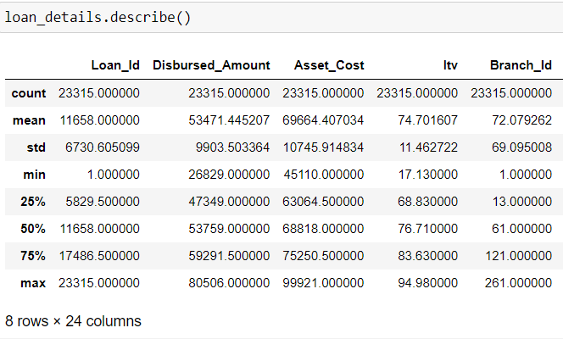
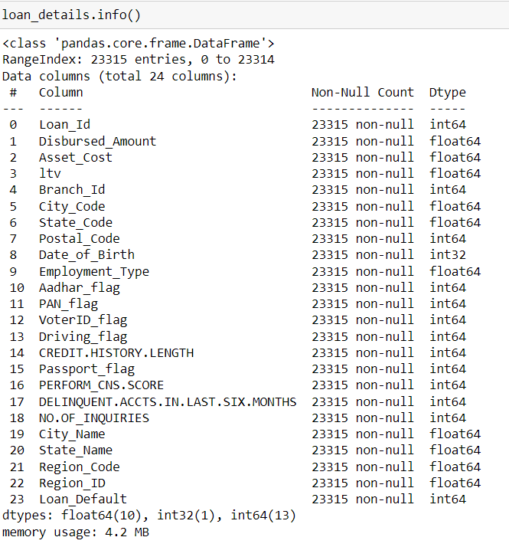
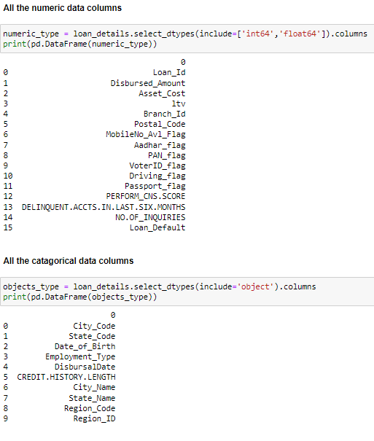

DATA
EXPLORATION

Slide 7

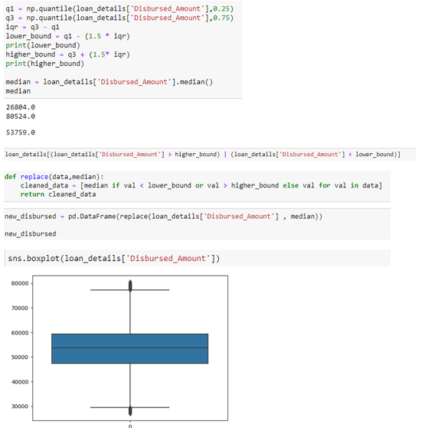
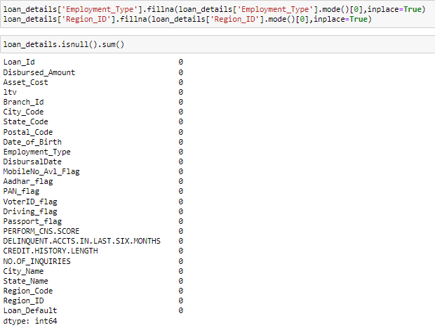
DATA
CLEANING
Missing Values Handling
Outliers
Handling

Slide 8
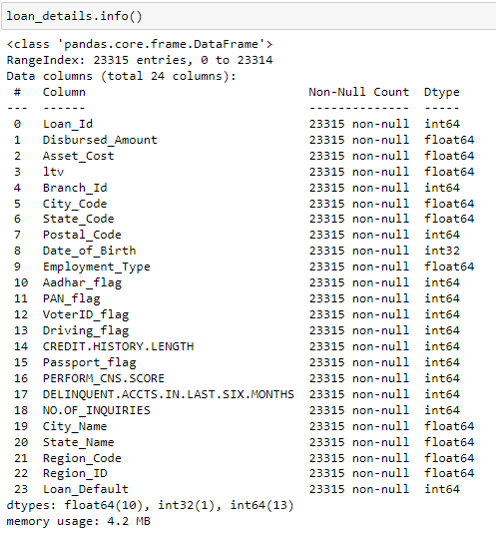
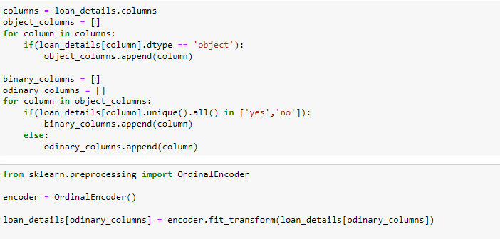
DATA
TRANSFORMATION
ENCODING

Slide 9
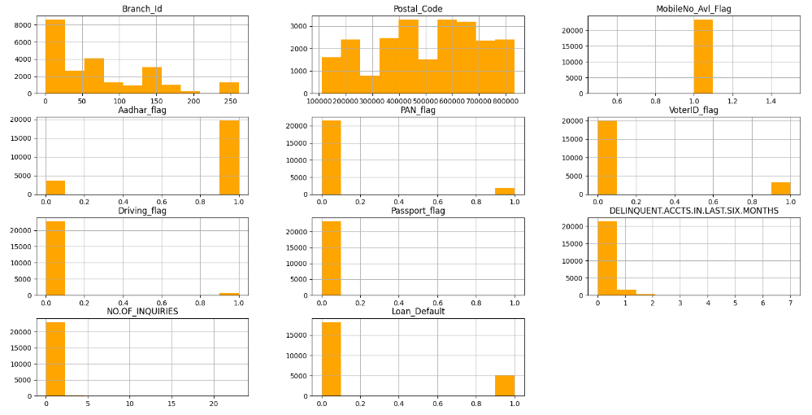
DATA
VISUALIZATION
UNIVARIATE ANALYSIS

Slide 10
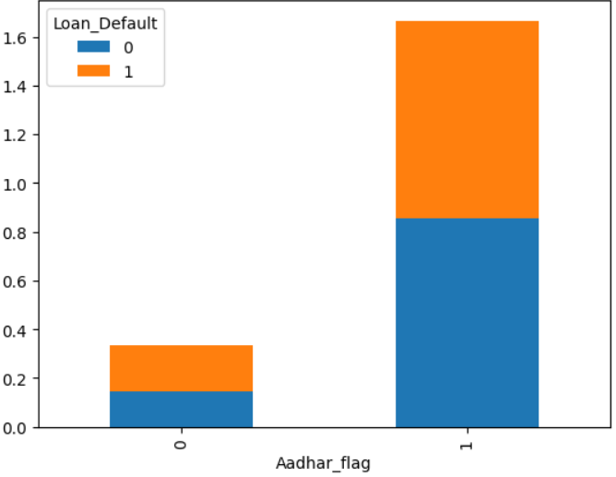
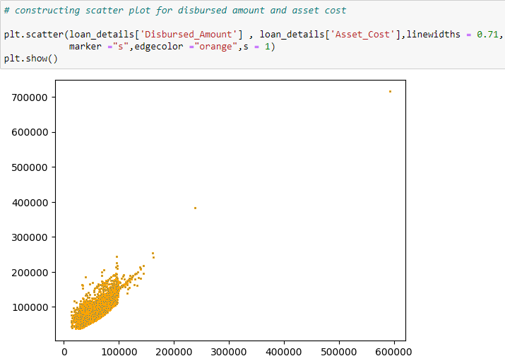
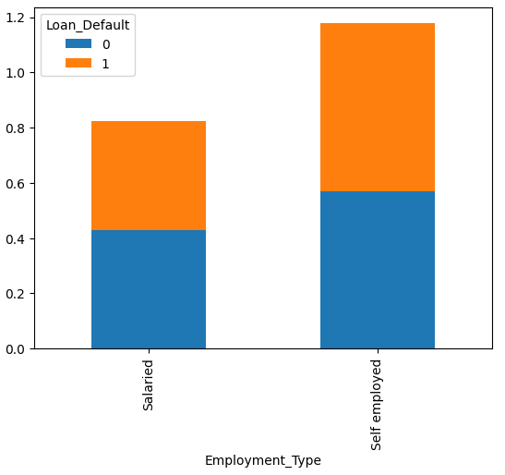
DATA
VISUALIZATION
BIVARIATE
ANALYSIS

Slide 11
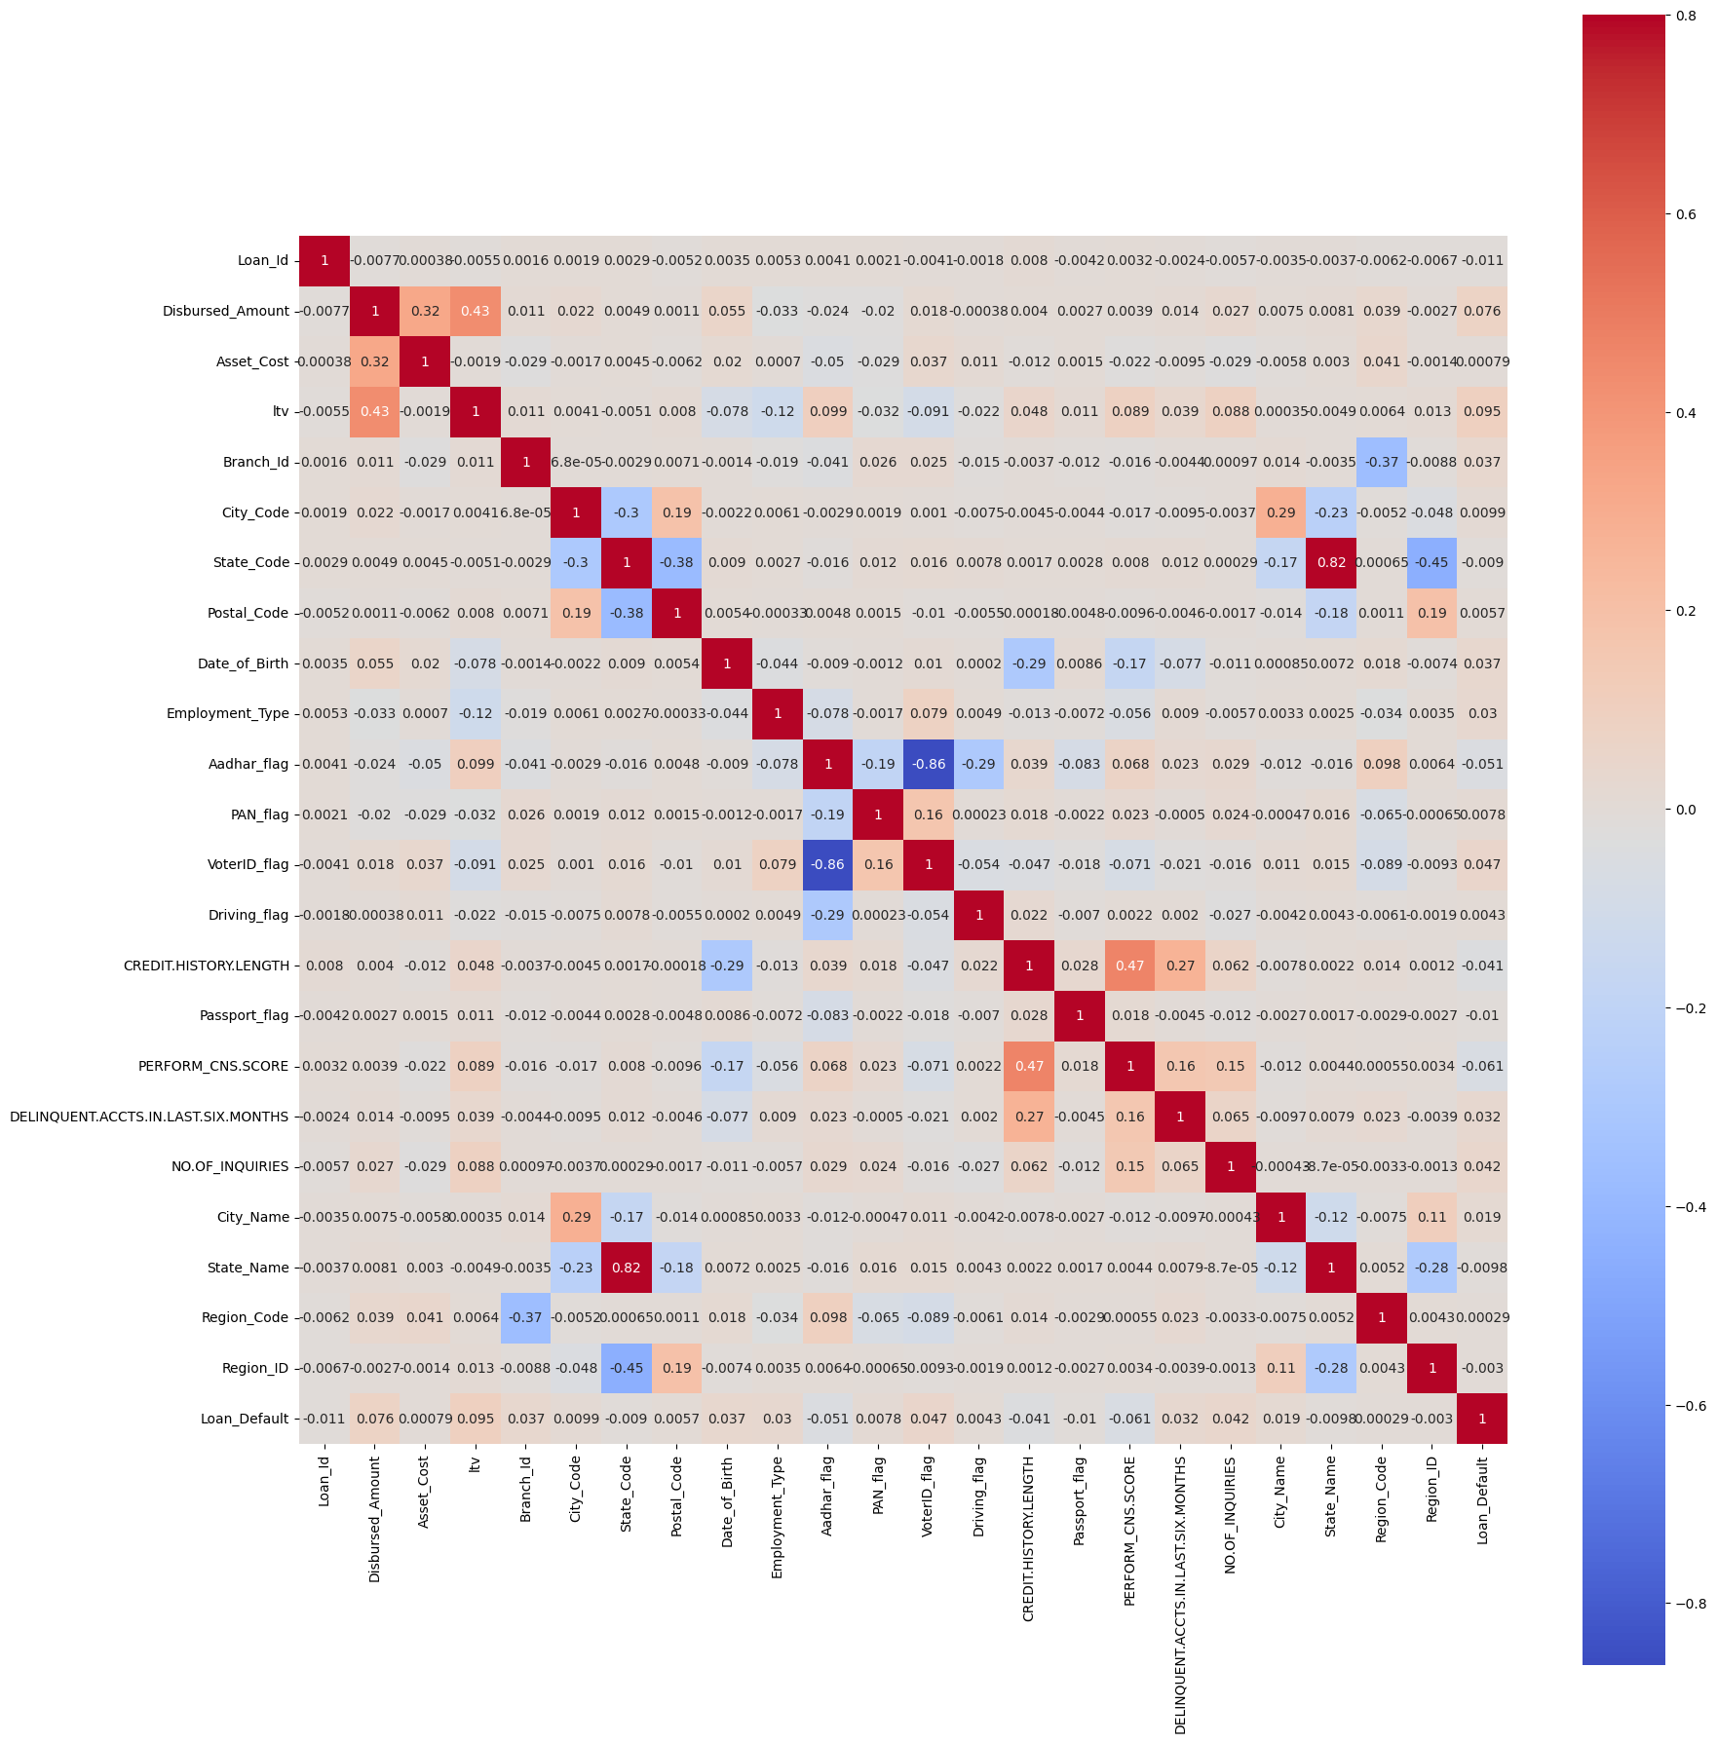
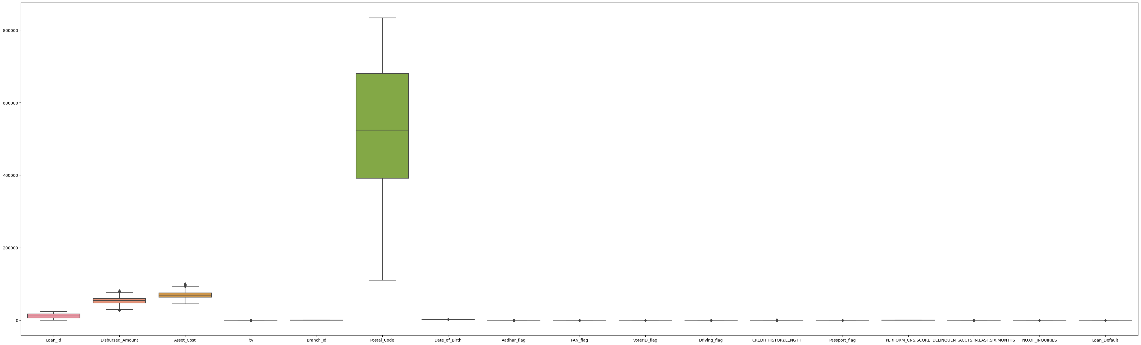
DATA
VISUALIZATION
Box Plot
Heat Map

Slide 12
CheckPoint 2
Creating Power-BI dashboard for visualization of the dataset for better insights
Checking for accuracy in the prediction with respect to actual.
Building confusion matrix for more clarity.
Model selection –
Train & Test dataset
Model creation –
Logistic Regression
Logistic Regression(Smote)
K-Fold Cross-Validation
Visualization
Power-BI
MODEL
CREATION
MODEL
EVALUATION

Slide 13
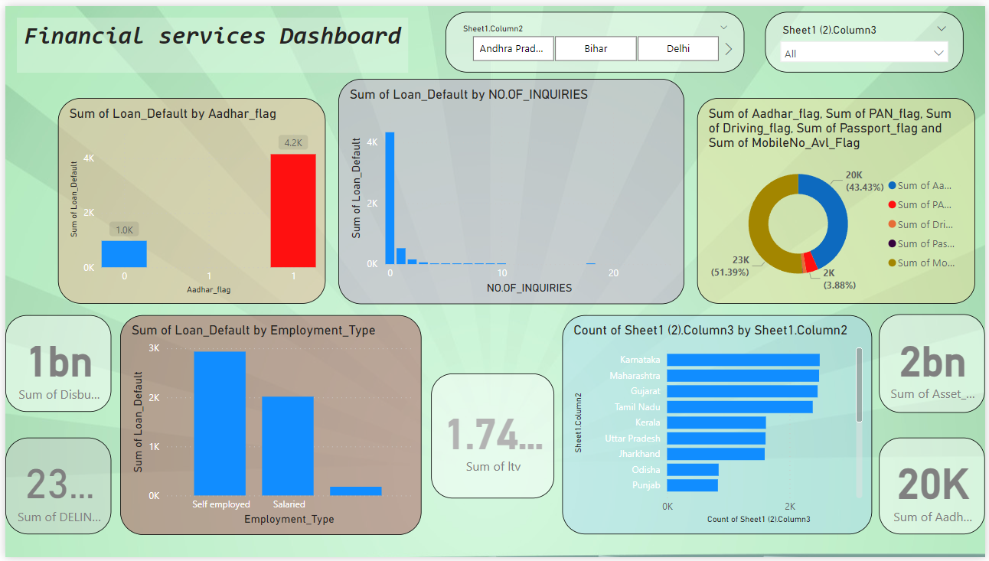
Visualization Power-bi

Slide 14
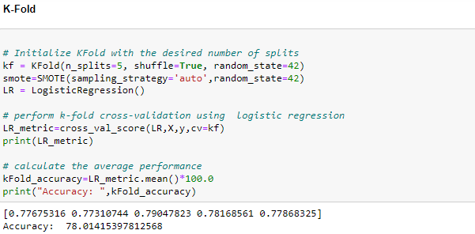
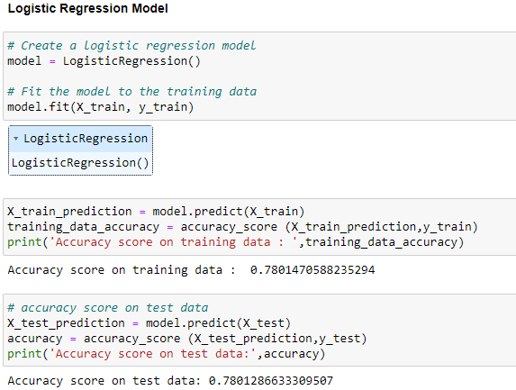
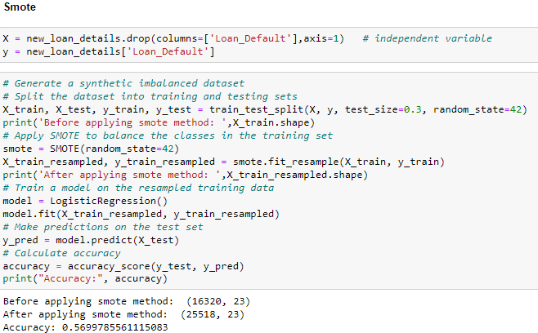
MODEL CREATION

Slide 15
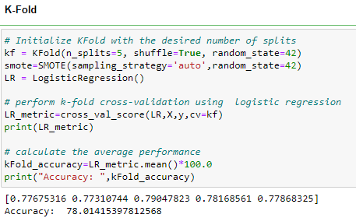
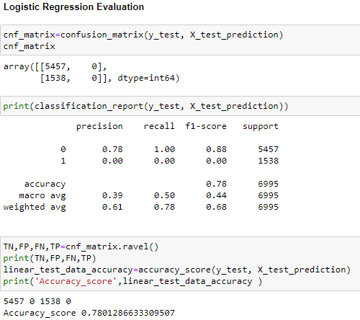
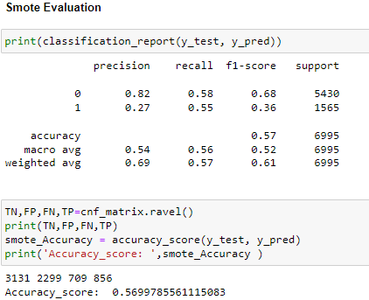
MODEL Evaluation

Slide 16
RESULTS
ML TECHNIQUES | ACCURACY
Logistic Regression | 78.012 %
Logistic Regression (Smote) | 56.98%
K-Fold Cross Validation | 78.014 %

Slide 17
Conclusion
Logistic Regression (Accuracy: 78.012%): Simple and interpretable model suitable for balanced datasets with linear relationships.
Logistic Regression with SMOTE (Accuracy: 57%): Addresses class imbalance, but introduced synthetic data might impact accuracy negatively.
K-Fold Cross-Validation (Accuracy: 78.014%): Robust evaluation technique that provides a reliable estimate of model performance on unseen data.
Data Imbalance: Logistic Regression struggles with imbalanced data; SMOTE helps but may not always improve accuracy.
Model Complexity: Logistic Regression is simple, k-Fold enhances model evaluation; consider complexity-tradeoff.
Interpretability: Logistic Regression is interpretable; SMOTE and k-Fold focus on model evaluation and data handling.
Recommendation: Utilize k-Fold Cross-Validation with logistic regression (or other models) for robust model assessment.

